Slide 1

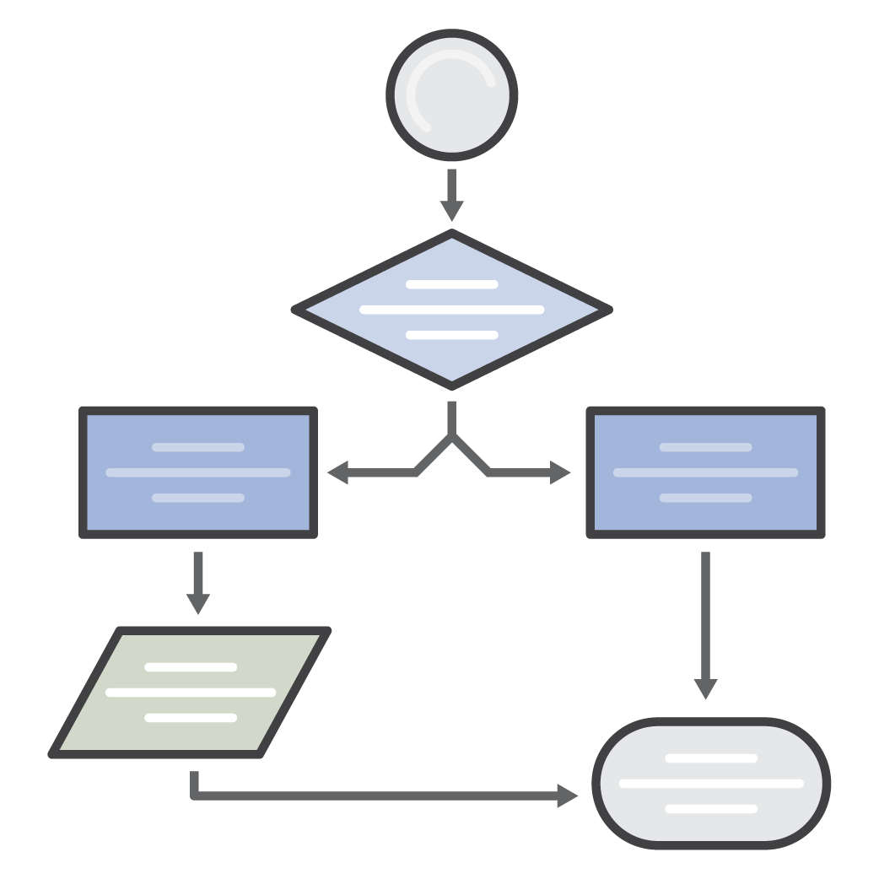



AWS Simple Icons
Check to make sure you have the most recent set of AWS Simple Icons
Find the most recent set at: aws.amazon.com/architecture/icons/
Always use icon labels
Be sure to always include a label below the icon or on the group in Arial. The only exception is in complex diagrams; you have the option to create a key.
Non-AWS technology
Any server or other non-AWS technology in an architecture diagram should be represented with the grey server (see Slide 29).
Creating diagrams
Try to use direct lines (rather than ‘criss-cross’), use adequate whitespace, and remember to label all icons.
Console icons
The first icon in most service sets is the console icon. These should be used to represent the service on a more general level when you will not be going into as much depth.
cluster
Amazon EC2
traditional server
AWS Simple Icons: Usage Guidelines

Slide 2
Table of Contents
Compute
4
Analytics
24
Business Productivity
42
Storage
7
Artificial Intelligence
27
Desktop & App Streaming
44
Database
9
Internet of Things
29
General
45
Networking & Content Delivery
12
Contact Center
32
On-Demand Workforce
46
Migration
14
Game Development
34
SDKs
47
Developer Tools
16
Mobile Services
36
Groups
48
Management Tools
18
Application Services
38
Example
50
Security, Identity, & Compliance
21
Messaging
40

Slide 3
Compute

Slide 4






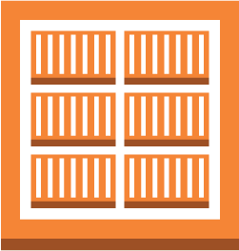





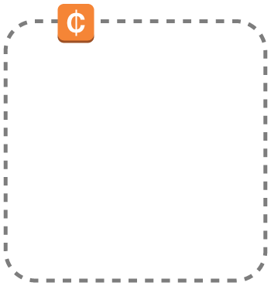






Compute
Compute icons continue on next slide
Amazon EC2
Amazon ECR
Amazon ECS
Amazon Lightsail
AMI
Auto Scaling
DB on instance
Elastic IP address
ECR registry
ECS
container 1
instances
instance with CloudWatch
optimized instance
Spot Fleet
ECS
container 2
instance
Spot Instance
X1 instance
EC2
rescue
ECS
container 3

Slide 5






















Compute (Continued)
Amazon VPC*
AWS Batch
AWS Elastic Beanstalk
AWS
Lambda
Elastic Load Balancing*
customer gateway
elastic network adapter
elastic network interface
endpoints
application
Lambda function
Classic Load Balancer
flow logs
Internet gateway
router
VPC NAT gateway
deployment
Application Load Balancer
VPC peering
VPN connection
VPN gateway
network access control list
* Refers to services that are listed under multiple categories.

Slide 6
Storage

Slide 7

















Storage
Amazon S3
Amazon
EFS
Amazon Glacier
AWS Storage Gateway
AWS Snowball*
bucket
file system
archive
cached volume
import/ export
Amazon EBS
bucket with objects
vault
non-cached volume
snapshot
object
virtual tape library
volume
* Refers to services that are listed under multiple categories.

Slide 8
Database

Slide 9
























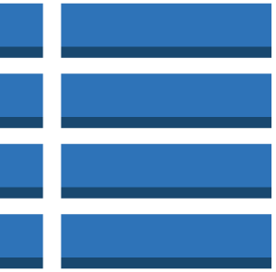

Database
Database icons continue on next slide
Amazon RDS
Amazon DynamoDB
Amazon DynamoDB Accelerator
Amazon ElastiCache
MS SQL instance
MS SQL instance alternate
MySQL DB instance
MySQL instance alternate
Oracle DB instance
attribute
attributes
cache node
Oracle DB instance alternate
PIOP
Postgre SQL instance
RDS DB instance
global secondary index
item
Memcached
RDS DB instance standby (multi-AZ)
RDS DB instance read replica
SQL master
SQL slave
items
table
Redis

Slide 10





Database (Continued)
Amazon Redshift
AWS DMS
dense compute node
database migration workflow/job
dense storage node

Slide 11
Networking & Content Delivery

Slide 12






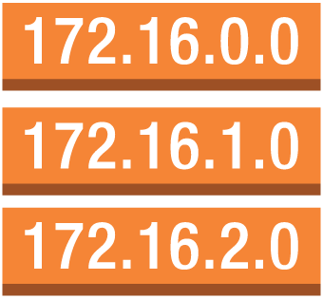

Networking & Content Delivery
Amazon VPC*
Amazon CloudFront
Amazon Route 53
AWS Direct Connect
Elastic Load Balancing*
customer gateway
elastic network adapter
elastic network interface
endpoints
download distribution
hosted zone
Classic Load Balancer
flow logs
Internet gateway
router
VPC NAT gateway
edge location
route table
Application Load Balancer
VPC peering
VPN connection
VPN gateway
network access control list
streaming distribution
* Refers to services that are listed under multiple categories.

Slide 13
Migration

Slide 14



Migration
AWS Migration Hub
AWS Application Discovery Service
AWS DMS
AWS SMS
AWS Snowball*
database migration workflow/job
import/ export
* Refers to services that are listed under multiple categories.

Slide 15
Developer Tools

Slide 16






Developer Tools
AWS
CodeStar
AWS CodeCommit
AWS CodeBuild
AWS CodeDeploy
AWS CodePipeline
AWS
X-Ray

Slide 17
Management Tools

Slide 18



















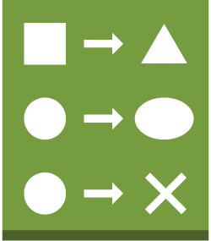

Management Tools
Management Tools icons continue on next slide
Amazon CloudWatch
Amazon EC2 Systems Manager
AWS CloudFormation
AWS CloudTrail
AWS Config
AWS Managed Services
alarm
event (time-based)
Automation
documents
Inventory
stack
rule
rule
Maintenance Windows
Parameter Store
Patch Manager
template
event (event-based)
Run Command
State Manager
change set

Slide 19
















Management Tools (Continued)
AWS OpsWorks
AWS Service Catalog
AWS Trusted Advisor
apps
deployments
instances
checklist
checklist cost
layers
monitoring
permissions
checklist fault tolerance
checklist performance
resources
stack
checklist security

Slide 20
Security, Identity & Compliance

Slide 21





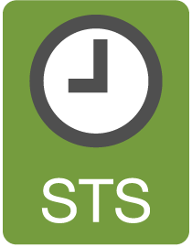











Security, Identity & Compliance
Security, Identity & Compliance icons continue on next slide
IAM
Amazon
Cloud Directory
Amazon Inspector
Amazon Macie
AWS Certificate Manager
add-on
AWS STS
AWS STS (alternate)
data encryption key
agent
certificate manager
encrypted data
long-term security credential
MFA token
permissions
role
temporary security credential

Slide 22








Security, Identity & Compliance (Continued)
AWS CloudHSM
AWS Directory Service
AWS KMS
AWS Organizations
AWS Shield
AWS WAF
AWS Artifact
filtering rule

Slide 23
Analytics

Slide 24










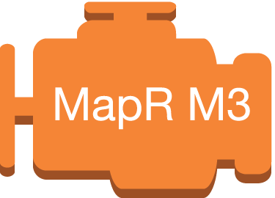


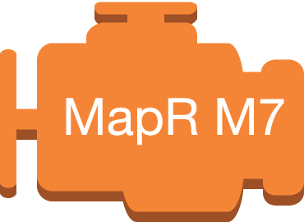
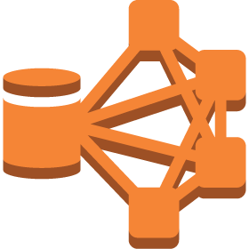

Analytics
Analytics icons continue on next slide
Amazon Athena
Amazon EMR
Amazon CloudSearch
Amazon ES
Amazon Kinesis
Amazon Redshift*
cluster
EMR engine
search documents
Amazon Kinesis Analytics
Amazon Kinesis– enabled app
dense compute node
EMR engine MapR M3
EMR engine MapR M5
Amazon Kinesis Firehose
dense storage node
EMR engine MapR M7
HDFS cluster
Amazon Kinesis Streams
* Refers to services that are listed under multiple categories.

Slide 25



Analytics (Continued)
Amazon QuickSight
AWS Data Pipeline
AWS Glue

Slide 26
Artificial Intelligence

Slide 27




Artificial Intelligence
Amazon
Lex
Amazon
Polly
Amazon Rekognition
Amazon Machine Learning

Slide 28
Mobile Services

Slide 29






Mobile Services
AWS Mobile Hub
Amazon API Gateway*
Amazon Cognito
Amazon Pinpoint
AWS Device Farm
Amazon Mobile Analytics
* Refers to services that are listed under multiple categories.

Slide 30
Application Services

Slide 31






Application Services
AWS Step Functions
Amazon
SWF
Amazon API Gateway
Amazon Elastic Transcoder
Amazon AppStream 2.0*
decider
worker
* Refers to services that are listed under multiple categories.

Slide 32
Messaging

Slide 33









Messaging
Amazon SQS
Amazon SNS
Amazon Pinpoint*
Amazon
SES
message
email notification
email
queue
HTTP notification
topic
* Refers to services that are listed under multiple categories.

Slide 34
Business Productivity

Slide 35



Business Productivity
Amazon Chime
Amazon WorkDocs
Amazon WorkMail

Slide 36
Desktop & App Streaming

Slide 37


Desktop & App Streaming
Amazon WorkSpaces
Amazon AppStream 2.0*
* Refers to services that are listed under multiple categories.

Slide 38
Internet of Things (IoT)

Slide 39


















Internet of Things (IoT)
Internet of Things (IoT) icons continue on next slide
AWS IoT
IoT thing bank
IoT thing bicycle
IoT thing camera
IoT thing car
IoT thing cart
IoT thing coffee pot
IoT thing door lock
IoT thing factory
IoT thing generic
IoT thing house
IoT thing lightbulb
IoT thing medical emergency
IoT thing police emergency
IoT thing thermostat
IoT thing travel
IoT thing utility
IoT thing windfarm

Slide 40

























Internet of Things (IoT) (Continued)
AWS IoT (Continued)
AWS Greengrass
IoT action
IoT actuator
IoT certificate
IoT desired state
IoT hardware board
IoT HTTP protocol
IoT HTTP/2 protocol
IoT MQTT protocol
IoT policy
IoT reported state
IoT rule
IoT sensor
IoT servo
IoT
shadow
IoT simulator
IoT topic
Alexa skill
Alexa smart home skill
Alexa voice service
Alexa enabled device
Echo
Fire TV
Fire TV stick
Lambda function

Slide 41
Game Development

Slide 42

Game Development
Amazon GameLift

Slide 43
Contact Center

Slide 44

Contact Center
Amazon Connect

Slide 45



















General
AWS cloud
AWS Management Console
forums
virtual private cloud
client
Internet
Internet alt1
Internet alt2
corporate data center
disk
generic database
office building
mobile client
multimedia
SAML token
SSL padlock
tape storage
traditional server
user
users
AWS Simple Icons: Non-Service Specific

Slide 46





On-Demand Workforce
Amazon Mechanical Turk
Amazon
Mechanical Turk
assignment/
task
human intelligence tasks (HIT)
requester
workers
Mechanical Turk vs. Amazon Mechanical Turk
Do not use simple "Mechanical Turk" to refer to Amazon Mechanical Turk. Use Amazon Mechanical Turk to describe the entire system, Amazon Mechanical Turk website for the worker website, and Amazon Mechanical Turk web service to describe the product.
AWS Simple Icons: On-Demand Workforce

Slide 47














SDKs
Android
iOS
Java
JavaScript
.NET
Node.js
PHP
Python (boto)
Ruby
Xamarin
AWS CLI
AWS Toolkit for Eclipse
AWS Toolkit for Visual Studio
AWS Tools for Windows PowerShell
AWS Simple Icons: SDKs

Slide 48
Groups
Auto Scaling group
Availability Zone
region
security group
Elastic Beanstalk container
EC2 instance contents
VPC subnet
server contents
AWS Simple Icons: Groups

Slide 49
Groups (Continued)
virtual private cloud
AWS cloud
corporate data center
AWS Simple Icons: Groups

Slide 50

Example: 2-Tier Scalable Web Application Architecture in 1 Zone
www.example.com
media.example.com
Amazon Route 53
CloudFront
distribution
web app
server
root volume
logs
Elastic Load Balancing
EC2 instance
security group
data volume
Amazon EBS snapshot
Amazon S3 bucket
Auto Scaling group
security group
Availability Zone #1
AWS Simple Icons: Example

